Slide 1

STUDENT RESOURCE AND INFORMATION SYSTEM
Nepal Engineering College, Changunarayan, Bhaktapur
Project Memebers:
Arjan KC
Ashok Ghimire
Marshal Babu Basnet
April 2013
Notes:
Respected Project cordinators and our colleauges that are present here. Please accept our warm welcome and prepare to be amazed at the idea of a new generation of classrooms that we are about to present to you today. Our project is titled “Student Resource and Information System” acronym for sris. This project is a part of the credit requirement of attaining the degree of Electronics and Communication Engineering at Nepal Engineering College which is affiliated to the Pokhara University.
Sris project team consist of three students under the supervision of Mr Dinesh Dangol, who is an Assistant Professor at Nepal Engineering College. We are Arjan, Ashok and Marshal. My name is Arjan K.C. I will be now initiate the presentation by proceeding to the other slide which describes about the background and statement of problems that led us to choose this project.

Slide 2
Background and Statement of problem
Padeology approaches used in the present context are not interactive.
Technology is not used to the fullest when it comes to education sector in Nepal.
Existing edutech solutions are expensive and unaffordable.
Very few amount of research has been done in the field of edutech implementation in Nepal.
Notes:
Formal teaching methodologies dates back to early 18th century during the Greek civilization. Three hundred years ago the Greeks required stone tablets with chalk to teach in their classroom. The subjects were basically theology and mathematics. Three hundred years later when we come to today, the classrooms do not seem to have unlocked the ease of use advancements that mankind has to offer.
Nepal is kept on the ranks of an underdeveloped country demoted from the developing nations list it was five years ago. In the recent five years we failed to incorporate the outburst of use of technology that other nations were busy exploring. In order to implement the approaches towards education technology that has been discovered is quite expensive and unaffordable to most of the educational institutions prevalent in Nepal.
If research is carried out in the sector of edutech implementation in Nepal, which is very scarce, we will stumble across a compatible edutech solution for implementation in Nepal.
Formal teaching methodologies dates back to early 18th century during the Greek civilization. Three hundred years ago the Greeks required stone tablets with chalk to teach in their classroom. The subjects were basically theology and mathematics. Three hundred years later when we come to today, the classrooms do not seem to have unlocked the ease of use advancements that mankind has to offer. Nepal is kept on the ranks of an under developed country demoted from the developing nations list it was five years ago. In the recent five years we failed to incorporate the outburst of use of technology. I would now like to move on to the next slide and describe the objectives and scope of our project.

Slide 3
Objective and scope
Technology is intended to make lives easier and increase productivity. The important task of impregnating and influencing ideas in a common classroom environment improves its efficiency if properly coupled with a suitable technology.
A flexible, cost efficient and collaborative edutech solution.
Can be used to collect data and information, conduct interactive surveys and enhance the teaching learning experience in the modern day classrooms.
Can be used to present ideas in an efficient manner in meetings and presentation too.
Notes:
Technology is intended to make lives easier and increase productivity. The important task of impregnating and influencing ideas in a common classroom environment improves its efficiency if properly coupled with a suitable technology. The main objective of our project is to improvise the existing approaches in the classroom enabling us to create a flexible, cost efficient and collaborative edutech solution. This approach towards education technology can be harnessed to collect data and information, conduct interactive surveys and enhance the teaching learning experience in the modern day classrooms by providing the instructors and their pupils the right tools to share, collaborate and enhance the teaching learning experience increasing the efficiency and productivity of the time allotted to the class.
These tools and applications bundled with sris can also be used to present ideas in an efficient manner in meetings and presentations too.
I would now like to ask my friend Ashok Ghimire to come up here and describe the applications of our project.

Slide 4
Application
For enhancing the teaching learning in modern days classrooms .
To present ideas in efficient manner in meetings, presentations and workshops and in any field where ideas has to be shared like presentations, seminars, expos etcetera.
Can be used to conduct Massive Online Open Courses (MOOCs).

Slide 5
Methodology
Extensive online survey and research of feasible edutech solution.
Collaborative environment designing using web designing tools.
Use of open source web designing tools and languages such as HTML 5, CSS 3, jquery, ajax and other scripts.
Interfacing devices to create a projection unit capable of connectivity, like a projector with raspberry pi.
Design of audio amplifiers and input device.

Slide 6
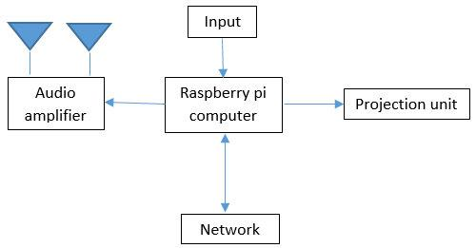
Block Diagram
Notes:
Hello, I’m marshal basnet, a project member of student resource and information system. let me describe block diagram first, combination of these 5 subunits forms sris, I’m going to describe these subunits shortly. physially raspberry pi is a atm card sized computer .powerful and light weight arm processor is used in this computer. RISC based computer design means arm architecture and it reduces number of transistor which reduces cost heat and power. hdmi port for video interface and graphics capability of pi are key features. for this project, simply it extract our web app resource from cloud and show it to big screen with the help of projector. projector is just a display unit. network block define our web application, which exist on server. Audio amplifier amplify the replay of recorded classes and to play YouTube videos. input device just change whiteboard app to resource and vice-versa. we can give two commands to perform these functions from pi.

Slide 7
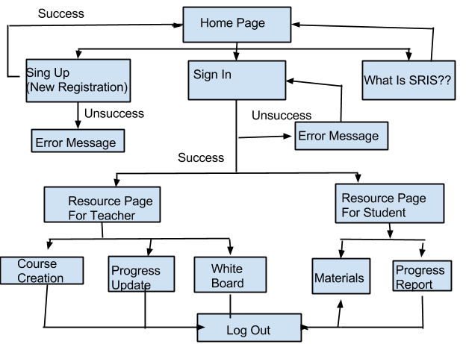
Navigational diagram of web application
Notes:
This is navigational chart of our application. first home page with logo of I and three button,sign up,sign in and what is sirs. sign up for new registration and to validate as registered user, user have to give their email and password in sign in section,if database query return right means seccess, user can enter in to resources whether he/she is teacher or student.if query returns false then it goes to main page. Teacher can create course,update progress of student and access whiteboard and in student part, visible section are only materials and progress report.user can exit from program with the help of logout buton. user cannot return back from resources to home page with back button of browser,if he/she try ,it again redirect back to same page. the email and password is assigned to session variable so that before execution of every page, email and password matching performed and if true then page loaded otherwise user kicked out from services.

Slide 8
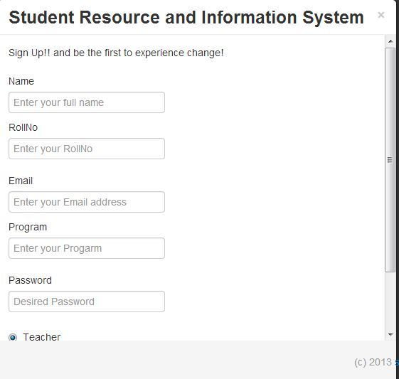
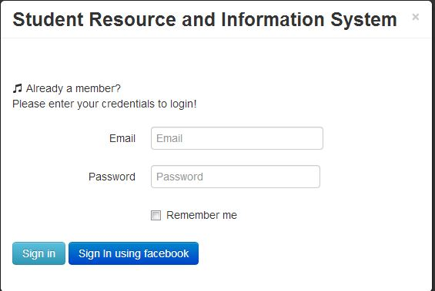
Work done so far
Registration section
Log in section

Slide 9
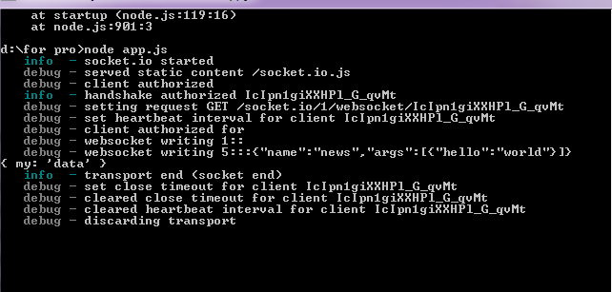
Work done so far
Used in real time communication apps, chat, mailing apps.
Combines the parts of UDP and TCP.
We use it to create a collaborative environment.

Slide 10
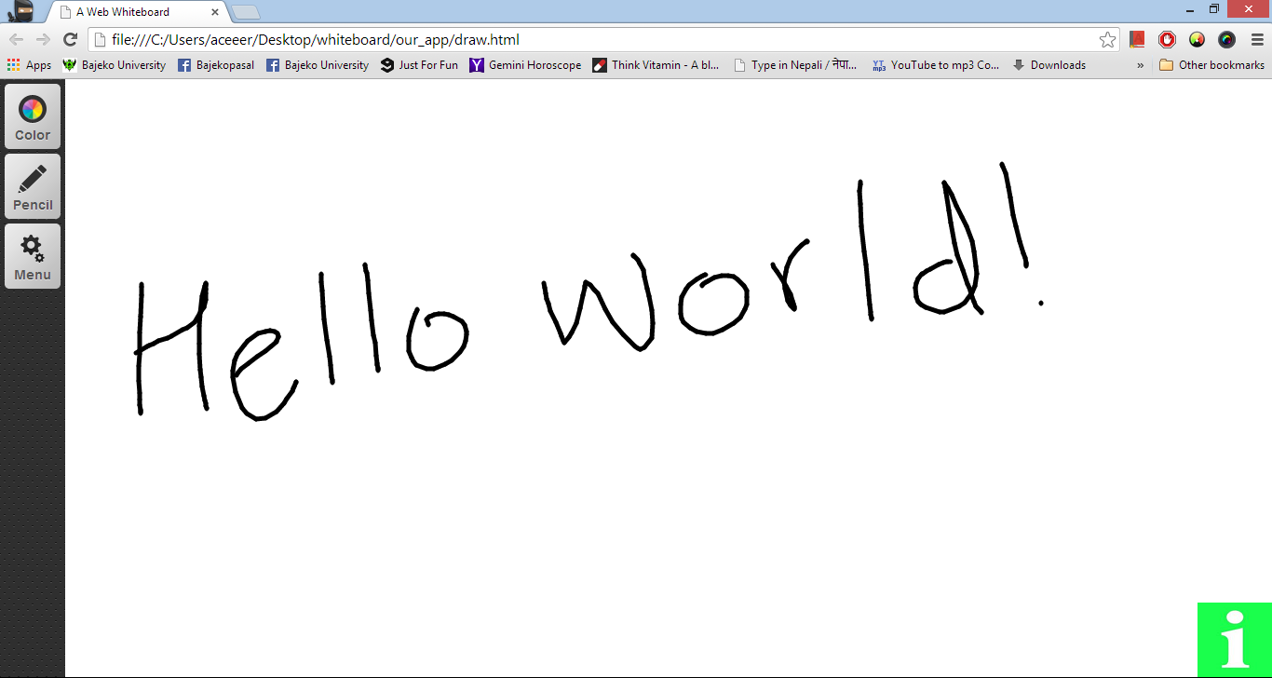
Work done so far
Whiteboard application
Notes:
We were develop a form for registration with field name, email, subject, faculty, roll no, and checkbox with two options teacher and student. user can provide their personal information to the system. password is encrypted for security reason. Log in part help to verify as registered user, email and password field is required for that. we have found a problem in real time communication between client and server so we are curious to see what’s the better for that. now days almost real time communication app, chatting, mailing used websocket protocols .once the connection is established, they remain connected throughout the process and it sends chunks of data to the server.in http protocol request is send everytime user send data and ends immediately when data sending stops. but websocket remains connected.socket.io is library and node.js platform is used for this purpose. In practice it combines the parts of UDP and TCP: it's message based like UDP, but it's reliable like TCP. Each message can also carry control information and is wrapped in a frame. upgrade header than in http.

Slide 11
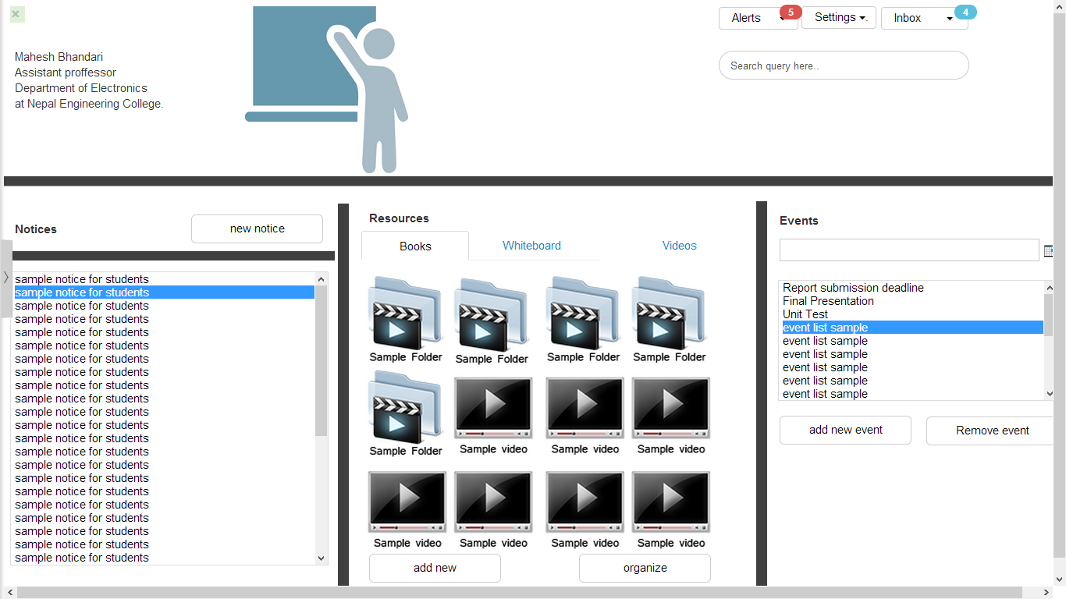
Work done so far
Wireframe designing and prototyping

Slide 12
Work done so far
Research on edutech in context of Nepal and the world.
BYOD (Bring Your Own Devices) classrooms being implemented around the world.
Virtual or Online learning.
Full time online schools.
Blended learning.
Open education resources.

Slide 13
Work done so far
Feature selection and application designing
Discussion module
User privilege
Sharing documents
Course creation system
Attendance system
Virtual whiteboard
User registration and login into the system

Slide 14
Work to be done
Amplifier, input device designing and circuitry management.
Booting raspberry pi with an open source operating system.
Domain registration and server space acquisitions.
Power source implications and energy efficiency research
Designing of online survey

Slide 15
Work Schedule for project completion
Task | Week 1st | Week 2nd |  | Week 3rd |  | Week 4th |  | Week 5th
Attendance
Course creation
Hardware implementation
Power source
Beta testing
Final testing
Report and presentation

Slide 16

Refrences: http://www.karvalschool.org/
http://www.ed.gov/oii-news/use-technology-teaching-and-learning
https://www.learnboost.com/
Please follow our blog for recent progress and information regarding the classroom project
http://sris3106.tumblr.com/
THANK YOU

